Slide 1
Open RAN
Dian Hanifudin Subhi

Slide 2
Outline
Weekly report
Summary of this week’s work
Your work
Conclusion
Your opinion/thought
Action item

Slide 3
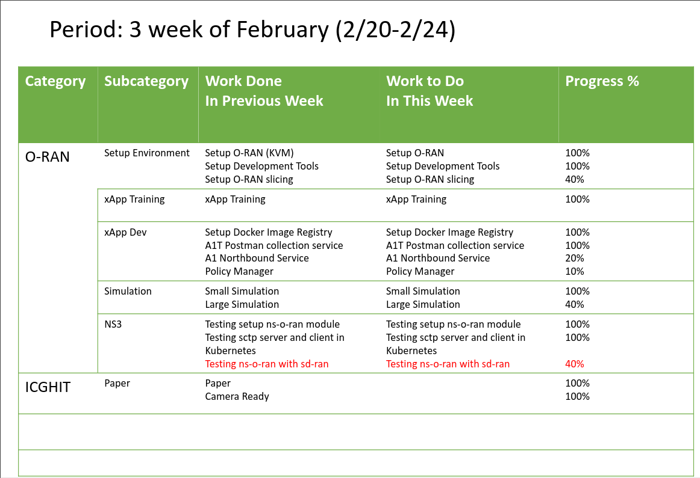
Weekly report

Slide 4
Summary of work this week
Integrate ns-3 with SD-RAN

Slide 5
Question to be Answered
What’s the issue compatibility between ns-o-ran and SD-RAN?

Slide 6
Testing related works
Setup ns-o-ran
Environments:
OpenRAN Gym
ns-3 oran interface
e2sim
ns-3-mmwave-oran
References:
https://openrangym.com/tutorials/ns-o-ran

Slide 7
Testing related works
Setup ns-o-ran
Result
xApp run without error
The simulation sometime is working
E2term can’t receive message from ns-3
ns-3 is waiting for SCTP data from e2term
There are no error from log

Slide 8
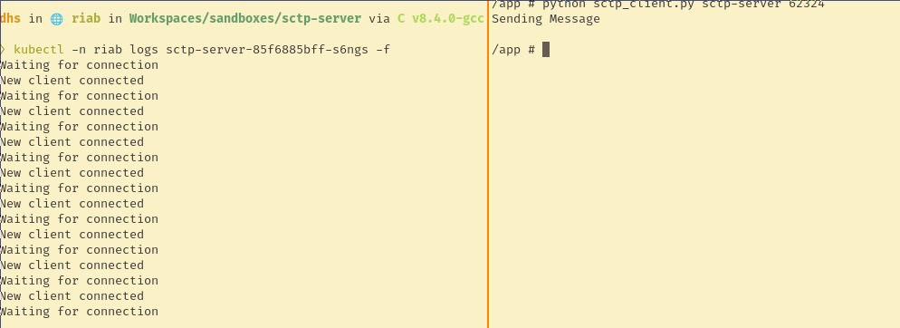
Testing Kubernetes Environment
Testing sctp server client communication
ns-o-ran using SCTP protocol to communicate between o-ran and ns-3
SCTP protocol based on UDP protocol
Kubernetes doesn’t support port forward UDP directly
Approach:
Build sctp-server and sctp-client as Kubernetes pod

Slide 9
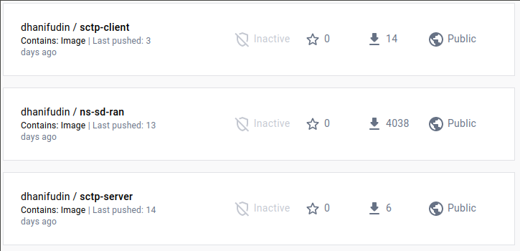
Building Image
Build tools as docker image
sctp-client: sctp client tools test
sctp-server: sctp dummy server
ns-sd-ran: ns3 with oran-interface docker image

Slide 10
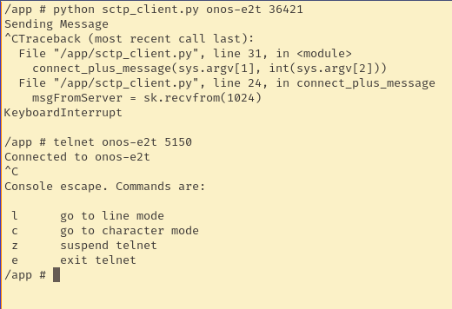
Testing Kubernetes Environment
Testing onos-e2t and sctp client communication
sctp-client can’t access onos-e2t sctp service
sctp-client can access onos-e2t grpc service using telnet
ns-o-ran using sctp protocol to communicate between OpenRAN Gym and ns-3

Slide 11
Testing In SD-RAN
Run ns3 oran module inside Kubernetes
Bundle ns-o-ran into helm package
Kubernetes pod require to define of the service
We need to create dummy service to keep ns-3 pod running

Slide 12
Conclusion
Unstable simulation using ns-o-ran with OpenRAN Gym stack.
There are problems with sctp communication between ns-3 and onos-e2t
Integration between ns-o-ran with SD-RAN requires deploying ns-o-ran as Kubernetes pod.

Slide 13
Your opinion/thought
Test connectivity between e2 termination using simple SCTP client
Enable log dashboard to gather log information easily
another alternative communication, using onos-e2t grpc service to communicate with ns-3. Similar approach used by ransim tools.

Slide 14
Action items
Bundle ns-o-ran into helm package and optimize compilation times.
Find information log related with ns-o-ran and OpenRan Gym

